Slide 1
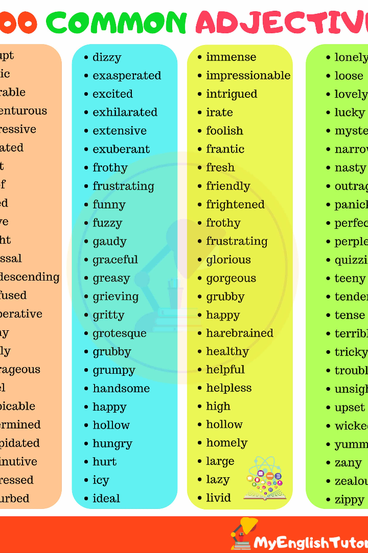

Adjectives and its types
Welcome to the world of adjectives! In this presentation, we will explore the various types of adjectives and their examples. Get ready for an engaging journey! 🚀
by Faseh Tariq

Slide 2

Definition of Adjectives and Examples
An adjective is a word that describes or modifies a noun or pronoun. It adds more meaning and details to the sentence. For example, "beautiful," "tall," and "smart" are adjectives. Let's dive deeper into the fascinating world of adjectives!

Slide 3
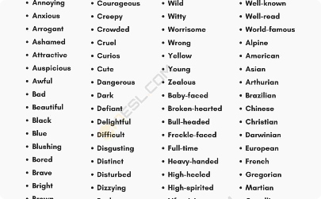


Descriptive Adjectives
Definition
Example
Additional Example
Descriptive adjectives vividly describe the characteristics, qualities, or attributes of a noun. They make our sentences more expressive.
For example, consider the adjective "happy." It helps us convey emotions and paint a picture in the reader's mind.
Similarly, descriptive adjectives can be used to provide details about color, size, shape, and more. They add life to our language.

Slide 4
Quantitative Adjectives
1
Definition
Quantitative adjectives specify the quantity or number associated with a noun. They add precision and clarity to our sentences.
Example
2
Consider the adjective "three." It helps us convey the exact quantity of a noun, allowing us to be specific in our descriptions.
3
Usage
Quantitative adjectives are invaluable when we want to express measurements, counts, or comparisons. They help us provide accurate information.

Slide 5

Demonstrative Adjectives
1
Definition
2
Example
3
Usage
Demonstrative adjectives point to specific nouns or indicate their proximity. They help us identify and distinguish objects.
The words "this," "that," "these," and "those" are demonstrative adjectives. They allow us to refer to things around us accurately.
These adjectives are used to avoid ambiguity in conversations and provide context. They are a crucial part of effective communication.

Slide 6
Possessive Adjectives
Definition
Example
Usage
Possessive adjectives indicate ownership or possession. They show relationships between people, places, and things.
Words like "my," "your," "his," "her," and "their" are possessive adjectives. They let us express ownership in a concise manner.
Possessive adjectives help us describe what belongs to whom. They play a crucial role in both written and spoken language.

Slide 7



Interrogative Adjectives
Definition
Example
Usage
Interrogative adjectives introduce questions and help identify the noun we are referring to in our query.
Interrogative adjectives include words like "which," "what," and "whose." They allow us to ask for specific information related to a noun.
These adjectives enable us to seek clarification, gather details, and deepen our understanding. They are essential in conversations and investigations.

Slide 8
Indefinite Adjectives
1
Definition
Indefinite adjectives express the quantity or quality of a noun in a non-specific or general way. They add versatility to our language.
Example
2
Words like "some," "all," "many," and "few" are indefinite adjectives. They help us describe an unspecified or approximate amount or number.
3
Usage
Indefinite adjectives allow us to discuss things in broad terms, without specifying exact figures or quantities. They help us make general statements.

Slide 9

Compound Adjectives
1
Definition
2
Example
Compound adjectives are created by combining two or more words to describe a noun or pronoun. They enrich our descriptive power.
Phrases like "blue-eyed," "well-known," and "high-pitched" are compound adjectives. They express unique qualities that cannot be described by a single word.
3
Usage
Compound adjectives allow us to be creative and specific in our descriptions. They enhance our ability to capture the essence of things.

